Slide 1
Retail sales data analysis using python library
Presented by
Jaikrishna
Keerthana
Sowmiya

Slide 2
Introduction
In this project we are importing the python libraries to analyze the dataset and visualizing the sales data
Below are the process performed with the dataset
Analysing the data
Cleaning the data
Handling outlier
Statistical summary
Visualizing the dataset

Slide 3
Loading and exploring the dataset
# Read the csv file and store into df
df = pd.read_csv('C:\\Users\\SHANKAR\\Documents\\python\\retail_sales_data.csv')
# Take a look at top 5 Rows of dataset
df.head()
# Information of dataset
df.info()
# no.of rows and columuns in dataset
print("[$] No Of Rows in dataset >> ",df.shape[0])
print("[$] No Of Columns in dataset >> ",df.shape[1])
# Stastical summary of Dataset
df.describe()
#Check for Duplicates
df.duplicated().sum()
#Check for Null Values
df.isnull().sum()

Slide 4
Cleaning the dataset
# Remove Unwanted Columns InvoiceNo and Description are of no use
df.drop(['InvoiceNo','Description'],axis=1,inplace=True)
# Fill NaN values in 'CustomerID' and 'EmployeeID' with a placeholder
df['CustomerID'].fillna(-1, inplace=True)df['EmployeeID'].fillna('Unknown', inplace=True)
# Check null values again
df.isnull().sum()
# Check the Datatypes of columns
df.dtypes
# Take a look at top 5 rows of Dataset
df.head()

Slide 5
Handling Outliner
# Assuming outliers are defined as values beyond 3 standard deviations from the mean
numeric_cols = df.select_dtypes(include=[np.number]).columns.tolist()for col in numeric_cols:
# Calculate the mean and standard deviation
mean = df[col].mean() std = df[col].std()
# Excluding the data which is not in our range
df = df[(df[col] >= mean - 3*std) & (df[col] <= mean + 3*std)]
# Again Check Shape of dataset
print("[$] No Of Rows in dataset >> ",df.shape[0])
print("[$] No Of Columns in dataset >> ",df.shape[1])

Slide 6
Data Visualization
# Visualization of numerical columns
numerical_columns = ['Quantity', 'UnitPrice', 'Discount', 'TotalPrice’]
# Create a 2x2 grid of plotsfig,
axs = plt.subplots(2, 2, figsize=(7, 7))
# Loop through the numerical columns and create a histogram for eachfor i, col in enumerate(numerical_columns):
row = i // 2 col_num = i % 2 sns.histplot(df[col], bins=30, kde=True, ax=axs[row, col_num]) axs[row, col_num].set_title(f'Distribution of {col}') axs[row, col_num].set_xlabel(col) axs[row, col_num].set_ylabel('Frequency')plt.tight_layout()plt.show()

Slide 7
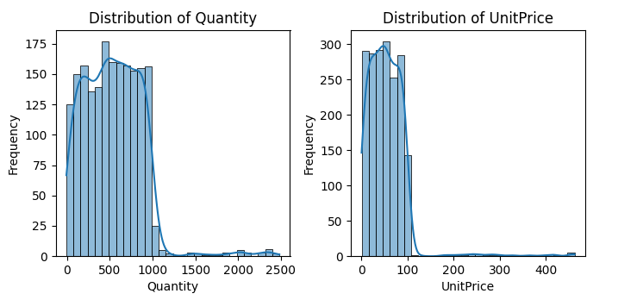
Histogram

Slide 8
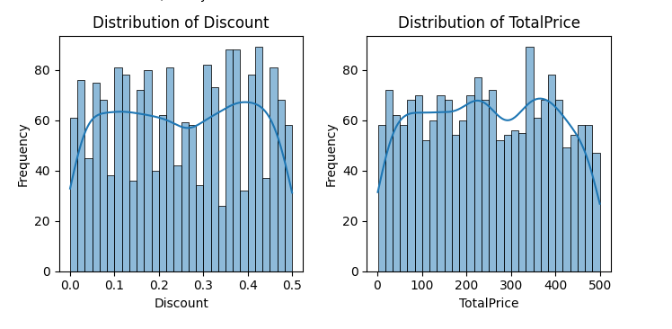
Histogram

Slide 9
Bar chart
# Create a figure and a set of subplots with 1 row and 2 columnsfig,
axes = plt.subplots(1, 3, figsize=(15, 5))# Plot the countplot for 'Country' on the first subplot (axes[0])sns.countplot(x='Country', data=df, ax=axes[0])axes[0].set_title('Count of Countries’)
# Plot the countplot for 'PaymentMethod' on the second subplot
(axes[1])sns.countplot(x='PaymentMethod', data=df, ax=axes[1])axes[1].set_title('Count of Payment Methods’)
# Plot the countplot for 'PaymentMethod' on the second subplot
(axes[1])sns.countplot(x='StoreID', data=df, ax=axes[2])axes[2].set_title('Count of StoreID')# Show the plotplt.tight_layout()plt.show()

Slide 10
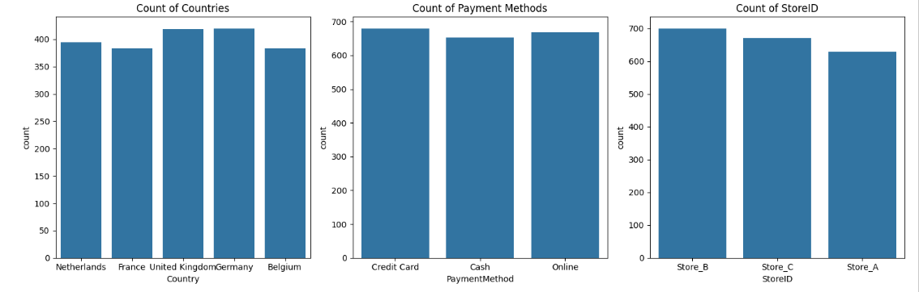
Bar chart

Slide 11
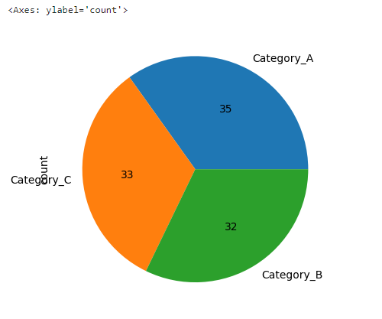
PIE chart
# Get counts for ProductCategory in our dataset
df.value_counts('ProductCategory').plot
(kind='pie',autopct='%.f')

Slide 12
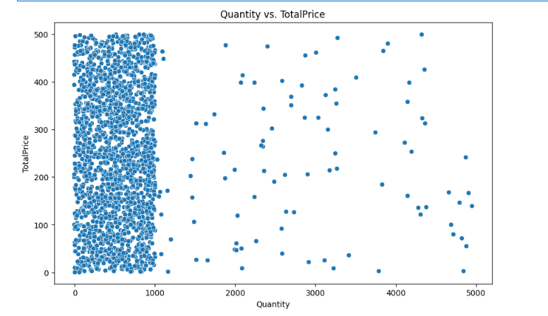
Scatter plot
# Scatter plot of Quantity vs. TotalPrice
plt.figure(figsize=(10, 6))sns.scatterplot(x='Quantity', y='TotalPrice', data=df)plt.title('Quantity vs. TotalPrice')plt.xlabel('Quantity')plt.ylabel('TotalPrice')plt.show()

Slide 13
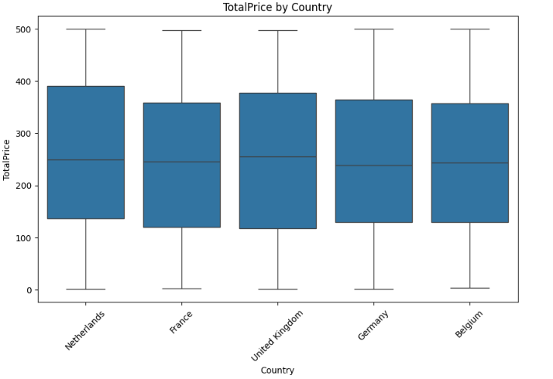
BOX PLOT
plt.figure(figsize=(10, 6))sns.boxplot(x='Country', y='TotalPrice', data=df)plt.title('TotalPrice by Country')plt.xlabel('Country')plt.ylabel('TotalPrice')plt.xticks(rotation=45)plt.show()

Slide 14
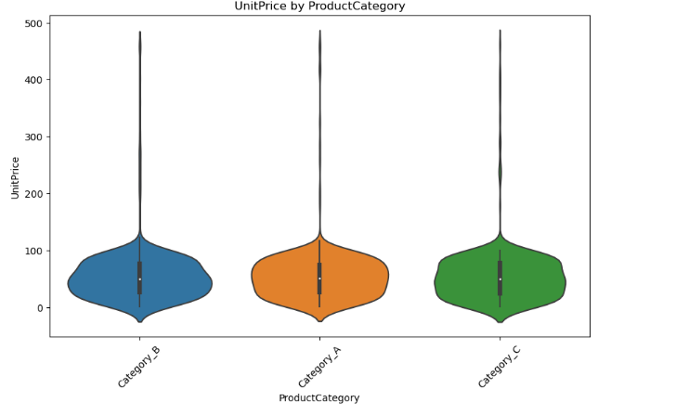
VIOLIN PLOT
# Violin plot of UnitPrice by ProductCategory
plt.figure(figsize=(10, 6))sns.violinplot(x='ProductCategory', y='UnitPrice', data=df)plt.title('UnitPrice by ProductCategory')plt.xlabel('ProductCategory')plt.ylabel('UnitPrice')plt.xticks(rotation=45)plt.show()

Slide 15
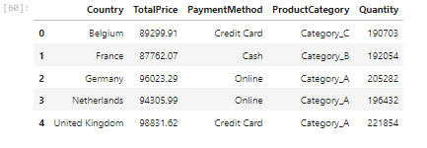
Groupby
df.groupby('Country').agg({ 'TotalPrice': 'sum', 'PaymentMethod': lambda x: x.mode()[0],
# Most frequent payment method
'ProductCategory': lambda x: x.mode()[0],
# Most frequent product category
'Quantity': 'sum'}).reset_index()

Slide 16
THANK YOU

